Slide 1
Symphony of the Scriptures
Obadiah
Notes:
Who wrote the book?
In this, the shortest book of the Old Testament, it seems the prophet Obadiah considered each word a high-priced commodity. Apparently, he was unable to afford any words describing himself or his family in any way. Therefore, while twelve other men named Obadiah appear in Scripture, Old Testament scholars cannot identify with certainty any of them as the author of this book. Though the ultimate identity of this prophet is shrouded in mystery, Obadiah’s emphasis on Jerusalem throughout this prophecy of judgment on the foreign nation of Edom, allows us at least to presume that Obadiah came from somewhere near the holy city in the southern kingdom of Judah.
Where are we?
Dating the book of Obadiah accurately is nearly impossible due to the scant historical information contained in the book. While several options have been proposed by scholars, the best argument places Obadiah in the 840s BC, making him the earliest writing prophet, a few years prior to Joel, and a contemporary of Elisha. The biggest piece of evidence for this early date comes from Obadiah 1:10–14, which indicates an Edomite invasion of Jerusalem. While Edom was too weak a nation to ever invade Judah on its own, Edom no doubt participated with other nations when the winds of change blew in its favor.
In the 840s, when Edom rebelled against King Jehoram of Judah, the Philistines and the Arabians also invaded Jerusalem The historical setting for Obadiah takes us to 2 Chronicles 21:4-16, in which Jehoram, King of Judah, followed in the idolatrous footsteps of many of his predecessors (cf. 2 Chron. 21:6). Because of this, not only did the nations of Edom and Libnah revolt against the Southern Kingdom, but the Lord also sent the Philistines and Arabs to attack its capital—Jerusalem—just as the prophet Elijah warned (cf. 2 Chron. 21:12-14). During the attacks from these nations, all of King Jehoram’s prized possessions taken, most of his family was captured, and he himself was run out of town.
While 2 Chronicles does not indicate the Edomites’ participation in the invasion, Obadiah 1:10–14 pictures the violent behavior that the Edomites carried out on their neighbors, waiting on nearby roads to cut down those fleeing from the invaders within Jerusalem. The Edomites could have easily heard of Jerusalem’s invasion by foreign powers and entered themselves into the fray so that they too might benefit from plundering their neighbors in Jerusalem.
To that end, Obadiah was commissioned by God to preach imminent judgment upon the Edomites. Their pride in victory would be short-lived, the security they felt in their mountainous terrain was but an illusion, and ultimately the nation would be “cut off forever” (Obad. 1:3, 10). And, in fact, the first two aspects of that prophecy came true centuries later when the Romans defeated both Jews and Edomites (known as Idumeans at the time) in AD 70. While some individual Edomites likely survived, the nation as a whole crumbled.
Why is Obadiah so important?
The majority of the book pronounces judgment on the foreign nation of Edom, making Obadiah one of only three prophets who pronounced judgment primarily on other nations (Nahum and Habakkuk are the others). While others of the prophetic books contain passages of judgment against Edom and other nations, Obadiah’s singular focus points to a significant, albeit difficult, truth about humanity’s relationship with God: when people remove themselves from or place themselves in opposition to God’s people, they can expect judgment, rather than restoration, at the end of life.
What's the big idea?
Obadiah’s name, meaning “worshipper of Yahweh,” offers an interesting counterpoint to the message of judgment he pronounced on Edom, Judah’s neighbor to the southeast.1 As a worshipper of Yahweh, Obadiah placed himself in a position of humility before the Lord; he embraced his lowly place before the almighty God.
That God sent a man named “worshipper of Yahweh” to the people of Edom was no mistake. Edom had been found guilty of pride before the Lord (Obadiah 1:3). They had thought themselves greater than they actually were; great enough to mock, steal from, and even harm God’s chosen people. But the “Lord GOD,” a name Obadiah used to stress God’s sovereign power over the nations, will not stand idly by and let His people suffer forever (1:1). Through Obadiah, God reminded Edom of their poor treatment of His people (1:12–14) and promised redemption, not to the Edomites but to the people of Judah (1:17–18). The nation of Edom, which eventually disappeared into history, remains one of the prime examples of the truth found in Proverbs 16:18: “Pride goes before destruction, / And a haughty spirit before stumbling.”

Slide 2
Obadiah
“Servant of Yahweh”
846 BC or 586 BC
Jacob & Esau –
from brothers
to nations
(read Gen. 25:
22-26;36:7-8)
Edom’s Humiliation
and
Destruction
Edom’s Cruelty
and
Crimes
Edom and the
Day of the Lord
Verses
1-9
Verses
10-14
Verses
15-21
Portent
Prediction
Denunciation
Consummation
Event
What will happen
Why it will happen
How it will happen
“The arrogance of your heart
has deceived you… I will bring you down.” (vv.3-4)
“Because of violence to your
brother Jacob…” (v.10)
“As you have done, it
will be done to you.” (v.5)
Content
Theme
The coming judgment of Edom
Key Verse
“Because of violence to your brother Jacob, You will be covered with shame,
And you will be cut off forever.” (v. 10)
Christ in
Obadiah
God’s judgment of Edom and deliverance of Israel – prefigure Christ’s salvation and judgment .
Notes:
The book of Obadiah is a strong warning to the proud. If assessed by its length one could say it is the “most minor” of all the minor prophets. It is the shortest book of the Old Testament. In the Symphony of the Scriptures, Obadiah seems to play an insignificant part in the orchestra’s performance. Not so! It’s twenty-one verses remind us in a powerful way that God stands by His redeemed. It is a small book that teaches great lessons. He had promised that the wicked nations who had persecuted God’s people would be be brought to their knees. Obadiah is a fresh reminder that, no matter who is against us, God is for us. While we cannot be sure about the date of this prophecy or the identity of the author, the author’s emphasis on Jerusalem suggests that he resided in the holy city. Unlike other prophets, Obadiah provides no strong rebukes to either Judah or Israel. Dating the book of Obadiah accurately is nearly impossible due to the scant historical information contained in the book. While several options have been proposed by scholars, the best argument places Obadiah in the 840s BC, making him the earliest writing prophet, a few years prior to Joel, and a contemporary of Elisha. The biggest piece of evidence for this early date comes from Obadiah 1:10–14, which indicates an Edomite invasion of Jerusalem. While Edom was too weak a nation to ever invade Judah on its own, Edom no doubt participated with other nations when the winds of change blew in its favor. Obadiah 1:10–14 pictures the violent behavior that the Edomites carried out on their neighbors, waiting on nearby roads to cut down those fleeing from the invaders within Jerusalem. The Edomites could have easily heard of Jerusalem’s invasion by foreign powers and entered themselves into the fray so that they too might benefit from plundering their neighbors in Jerusalem. The conflict between Edom and Israel is mentioned in more Old Testament books than it is against any foreign nation (Isa. 11:14; 34:5-17; 63:1-6; Jer. 9:25-26; 25:17-26; 49:7-22; Lam. 4:21-22; Ezek. 25:12-14; 35; Joel 3:19; Amos 1:11-12; Mal. 1:4). This leads one to ask, “What did Edom do to arouse God’s wrath?” Located to the east and south, they were proud, arrogant and self-sufficient. Most of all, they looked down on and hated the chosen people of God -- an animosity that went all the way back to Genesis. Remember that Esau had traded his birthright for a bowl of soup and “two nations” were formed with the older (Esau) serving the younger (Jacob) (Gen. 25:22-26). Later, Esau becomes Edom (“red”) and after Jacob, with his mother’s help, deceives his father and receives the blessing intended for the older brother. Esau vows he will kill Jacob for stealing his birthright. Both Esau and Jacob initially settled in Canaan but the two became two nations -- Jacob became Israel - Esau became Edom. When the land “could not sustain them” (Gen. 36:7), Esau moved to the “the hill country of Seir” (36:8), leaving Jacob with all of Canaan. The animosity of the two nations flourished when Edom refused passage through their land to the fleeing Israelites who had escaped Egyptian slavery (Ex. 12:40-41; Nu. 20:14-21. Note: the ancient fortress of Petra (Sela) provided a high/safe place where passageway was extremely difficult and it made it easy for them to wage war and levy tribute to those passing by No wonder the Edomites would crow, “Who will bring me down to earth?” (v.3). “I will,” says God! One person wrote, “Edom has become guilty of misplaced pride, glorying in its own accomplishments, oblivious to the reality that God is in charge and their success or failure is in God’s hands.” --- Daniel J. Simundson, Truth for Today, The Minor Prophets-2, page 31.
Application
God is for His people and with His people. What enemy should we fear?
It is not just God’s enemies that can become prideful; God took Israel and Judah down for their self-exaltation as well.
We need to remember that God wants us to depend on Him - to find our security in Him. He alone is our Fortress, our Rock, Shield, and Protector. He is the Source of our blessings.
Be assured, if we think too highly of ourselves, God will bring us down!
Key thought: “Pride goes before destruction, and a haughty spirit before a fall” (Pro. 16:18; 1 Pe. 5:6).

Slide 3
The Book of Obadiah
The shortest book in the Old Testament – only 21 verses.
The prophet makes no reference to himself, his origin or his family. There are 12 Obadiah’s in scripture, but none can be positively identified as this writer.
Multiple mentions of Jerusalem and Mount Zion make it probable that he prophesied from this vicinity of Judah.
Obadiah is one of only three prophets to pronounce judgment only on nations outside of God’s people. (The others are Nahum and Jonah, both preaching to Nineveh in Assyria)
Judgment is pronounced on the foreign nation of Edom.
Other prophets (Isaiah, Jeremiah, Ezekiel, Joel, Amos & Malachi) also spoke against Edom as one among many nations.
For a small book, Obadiah has a strong message: a warning to the proud, teaching that wicked nations that had persecuted God’s people will ultimately be punished.

Slide 4
Regarding the Book’s Date
Two dates are often proposed: 845 BC and 586 BC.
The prophet refers to a significant attack on Jerusalem. Of six historical conflicts, commentators offer these two possibilities:
During the days of Jehoram (848-844 BC), when Philistines and Arabians attacked the city (2 Chron 21:8-10,16-17)
The destruction of Jerusalem by the Babylonians (586 BC)
Evidence supporting the early date of 845 BC:
There is no mention of the destruction of the temple, the deportation to Babylon, the remnant who went to Egypt
Joel 2:32 appears to quote Obadiah 1:17, and Joel is likely at least 200 years before Jeremiah. (“On Mount Zion there shall be deliverance”)
Evidence supporting the late date of 586 BC:
Similar wording in Obadiah with Jeremiah 49 in multiple verses.
Psalms 137 reports Edom’s participation in the 586 BC attack.
Note that the fulfilment of all Obadiah’s prophesies occur after either date. (Begins with Edom conquered by Babylon in 575 BC.)

Slide 5
Period | History Covered | Scriptures | Years | Principal
Antediluvian | Creation to the Flood | Gen. 1-7 | 1656 | Adam
Postdiluvian | From the flood to call of Abraham | Gen. 8-!1 | 427 | Noah
Patriarchal | From the call of Abraham to Egyptian Bondage | Gen. 12-45 | 215 | Abraham
Egyptian Bondage | From Egyptian Bondage to the Exodus | Gen. 46-Ex. 11 | 215 | Joseph
Wilderness Wanderings | From Exodus to crossing of the Jordan | Ex. 12-Deut. 34 | 40 | Moses
Conquest of Canaan | From crossing of Jordan to Joshua’s death | Josh. 1-24 | 51 | Joshua
Judges | From Joshua to King Saul | Ju, Ruth, 1 Sa. 1-9 | 305 | Samuel
The United Kingdom | From origin of kingdom to its division | 1 Sa. 9-1 Ki. 11; 1 Chr. 10, 2 Chr. 9 | 120 | David
The Divided Kingdom | From the division to the fall of Israel | 1 Ki. 12-2 Ki. 20; 2 Chr. 10-32 | 253 | Elijah
Judah Alone | From fall of Israel to the fall of Judah | 2 Ki. 21-25; 2 Chr. 10-32 | 125 | Josiah
Babylonian Captivity | From the fall of Judah to the return | 2 Ki. 25-8- 21; Dan. 1-6; Ezekiel | 70 | Daniel, Ezekiel
Restoration of the Jews | From the return to end of OT history | Ezra, Nehemiah | 92 | Ezra
Between the Testaments | From end of OT to the beginning of the NT | None | 400 | Judas Maccabe
Life of Christ | From birth of Jesus to ascension | Mt-Jhn 21; Acts1 | 34 | Jesus
The Church | From ascension to death of Paul (96 AD approx.) | Acts 2-Revelation | 70 | Paul

Slide 6
CHRONOLOGY OF PROPHETS
9th Century
Prophets
Assyrian Exile - Israel 722 BC
Babylonian Exile- Judah 586
8th Century
Prophets
7th and 6TH
Century
Prophets
Exilic
Prophets
Postexilic
Prophets
Jonah
Amos
Hosea
Haggai
Zechariah
Malachi
Israel
Daniel
Ezekiel
Obadiah
(early date)
Joel
Isaiah
Isaiah
Nahum
Zephaniah
Habakkuk
Jeremiah
Obadiah
(late date)
Judah
Micah
Major prophets in bold, italics

Slide 7
Jonah
760 BC
Nahum
630 BC
Minor
Prophets
Timeline
Nineveh
Amos
755 BC
Hosea
750 BC
Israel
722
BC
586 BC
Divided
Kingdom
930 BC
536 BC
Judah Exile Return
Joel
830 BC
Micah
735 BC
Zephaniah
630 BC
Habakkuk
612 BC
Haggai
Zechariah
520 BC
Malachi
445 BC
Obadiah
845 BC
Obadiah
586 BC
Early date
Late date
Edom

Slide 8
Who wrote the book?
In this, the shortest book of the Old Testament, it seems the prophet Obadiah considered each word a high-priced commodity. Apparently, he was unable to afford any words describing himself or his family in any way. Therefore, while twelve other men named Obadiah appear in Scripture, Old Testament scholars cannot identify with certainty any of them as the author of this book. Though the ultimate identity of this prophet is shrouded in mystery, Obadiah’s emphasis on Jerusalem throughout this prophecy of judgment on the foreign nation of Edom, allows us at least to presume that Obadiah came from somewhere near the holy city in the southern kingdom of Judah.

Slide 9
Where are we?
Dating the book of Obadiah accurately is nearly impossible due to the scant historical information contained in the book. While several options have been proposed by scholars, the best argument places Obadiah in the 840’s BC, making him the earliest writing prophet (possible excpetion would be Joel). and he was a contemporary of Elisha. The biggest piece of evidence for this early date comes from Obadiah 1:10–14, which indicates an Edomite invasion of Jerusalem. While Edom was too weak a nation to ever invade Judah on its own, Edom no doubt participated with other nations when the winds of change blew in its favor.
In the 840s, when Edom rebelled against King Jehoram of Judah, the Philistines and the Arabians also invaded Jerusalem (2 Ki. 8:20–22; 2 Chr. 21:16–17). While 2 Chronicles does not indicate the Edomites’ participation in the invasion, Obadiah 1:10–14 pictures the violent behavior that the Edomites carried out on their neighbors, waiting on nearby roads to cut down those fleeing from the invaders within Jerusalem. The Edomites could have easily heard of Jerusalem’s invasion by foreign powers and entered themselves into the fray so that they too might benefit from plundering their neighbors in Jerusalem.

Slide 10
Why is Obadiah so important?
The majority of the book pronounces judgment on the foreign nation of Edom, making Obadiah one of only three prophets who pronounced judgment primarily on other nations (Nahum and Habakkuk are the others). While others of the prophetic books contain passages of judgment against Edom and other nations, Obadiah’s singular focus points to a significant, albeit difficult, truth about humanity’s relationship with God: when people remove themselves from or place themselves in opposition to God’s people, they can expect judgment.

Slide 11
What's the point?
Obadiah’s name, meaning “worshipper of Yahweh,” offers an interesting counterpoint to the message of judgment he pronounced on Edom, Judah’s neighbor to the southeast. As a worshipper of Yahweh, Obadiah placed himself in a position of humility before the Lord; he embraced his lowly place before the almighty God.
That God sent a man named “worshipper of Yahweh” to the people of Edom was no mistake. Edom had been found guilty of pride before the Lord (1:3). They had thought themselves greater than they actually were; great enough to mock, steal from, and even harm God’s chosen people. But the “Lord GOD,” a name Obadiah used to stress God’s sovereign power over the nations, will not stand idly by and let His people suffer forever (1:1). Through Obadiah, God reminded Edom of their poor treatment of His people (1:12–14) and promised redemption, not to the Edomites but to the people of Judah (1:17–18). The nation of Edom, which eventually disappeared into history, remains one of the prime examples of the truth found in Proverbs 16:18: “Pride goes before destruction, and a haughty spirit before a fall.”

Slide 12
How do I apply this?
Obadiah’s prophecy focuses on the destructive power of pride. It reminds us of the consequences of living in a self-serving manner, of following through on our own feelings and desires without considering their impact on those around us. Do you struggle to set aside your own wants and desires for those of God and others? Though such pride has been part of the lives of fallen human beings since the tragedy of the fall in Eden, Obadiah offers us a stark reminder to place ourselves under God’s authority, to subject our appetites to His purposes, and to find our hope in being His people when the restoration of all things comes.

Slide 13
Edom’s Humiliation & Destruction Verses 1 - 9
The coming judgment on Edom.
(All quotes from NKJV)
Obad 1:1-4
¹ The vision of Obadiah. Thus says the Lord GOD concerning Edom: (We have heard a report from the LORD, and a messenger has been sent among the nations, saying, "Arise, and let us rise up against her for battle")
² "Behold, I will make you small among the nations; You shall be greatly despised.
³ The pride of your heart has deceived you, you who dwell in the clefts of the rock, whose habitation is high; You who say in your heart, 'Who will bring me down to the ground?'
⁴ Though you ascend as high as the eagle, And though you set your nest among the stars, from there I will bring you down," says the LORD.
Who is Edom, and why are they considered “high”?

Slide 14
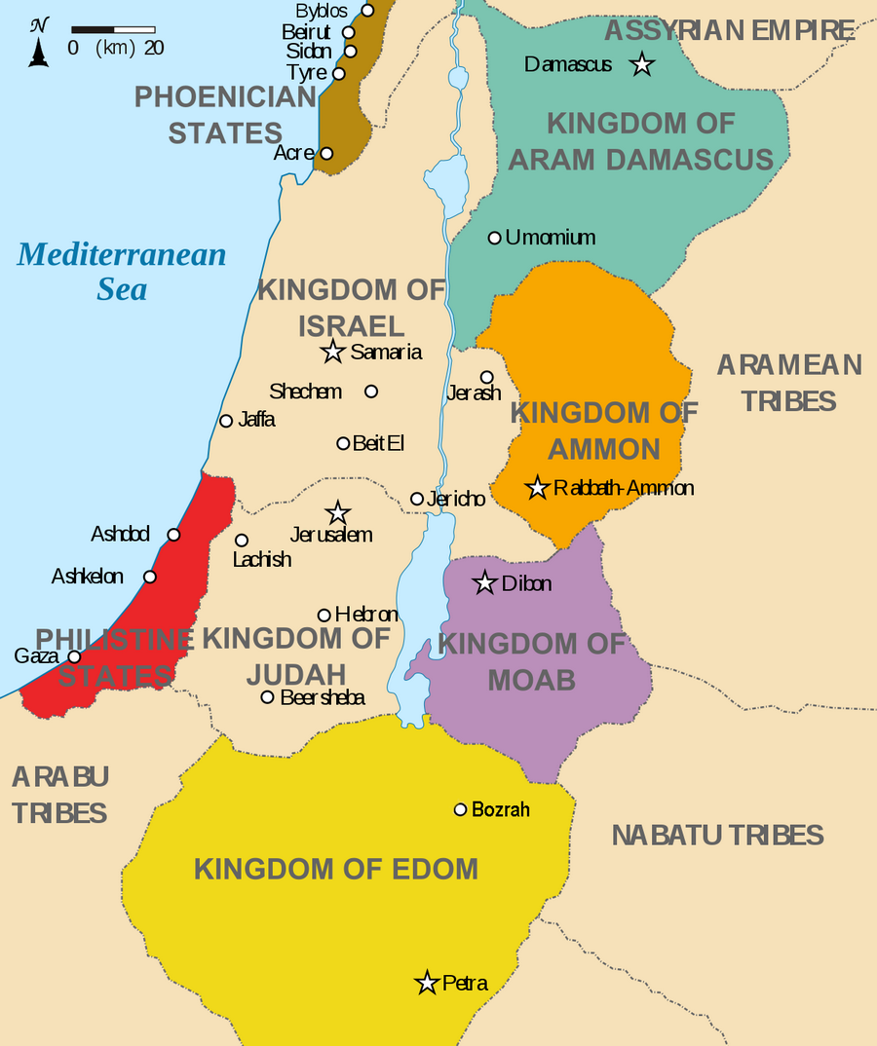
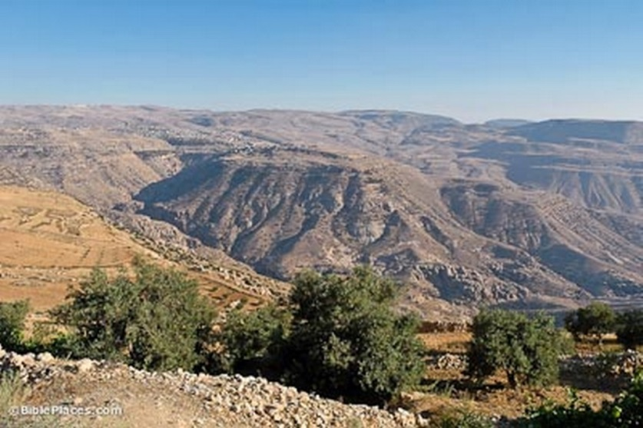
Kingdoms around
Israel in 830 BC
Edom lay south of Judah
in dry mountainous
country.
Its major cities mentioned
in the Bible include:
Bozrah, Teman, Dedan
& Petra (Sela)
View toward Bozrah
from the northwest

Slide 15
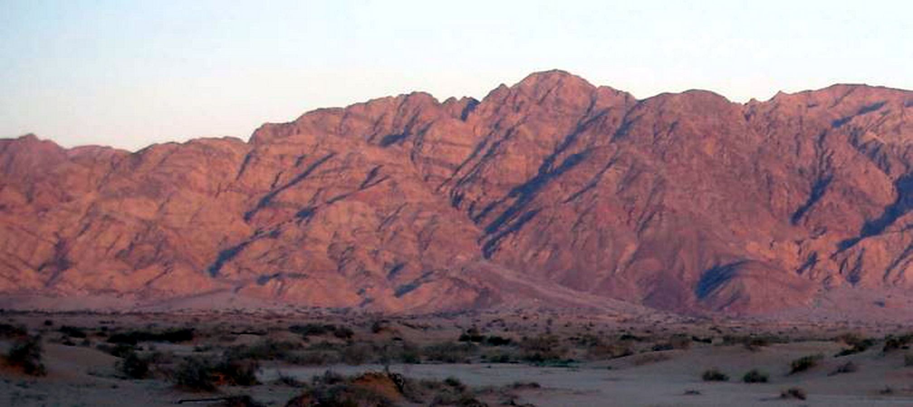
Red mountains of Edom (in Hebrew, “edom” means red.)
The cities of Edom (incl. Bozrah, Petra, Teman & Dedan) lay in the Seir Mountain Range along a major trade route. They flourished between the 13th and the 8th century BC, and considered their mountainous locations nearly invincible from attack from enemies. Thus in verse 3, Obadiah could say about the cities: whose habitation is high; You who say in your heart, 'Who will bring me down to the ground?'

Slide 16
Israel’s Neighbors (from the exodus until the division of the empire)
Period
Edom | Moab | Ammon
Esau: son of Issac | Moab: son of Lot and his eldest daughter | Ben-Ammi: son of Lot and his second daughter
The country was under control of Amorites. Refused passage to the Israelites (Num. 20:14-21) | The country was conquered by Sihon and the Amorites (Num. 21:26) King Balak feared Israel and sought the services of Baalam to curse them (Num. 22)
1350 BC - Continued under the partial control of the Amorites (Jud. 1:35-36) | 1350 BC - King Eglon oppressed Israel for 18 years Ehud delivered Israel by assassinating Eglon (Jud. 3:12-20) | 1350 BC - Ally of Eglon (Moab) 1100 BC - Oppressed Israel for 18 yrs. Defeated by Jepthah (Jud. 10-12)
1030 BC - Saul took Edomite cities 1000 BC - Edom conquered and subjugated by David (1 Chr. 18:22) | 1030 BC - Saul took cities from Moabites (1 Sam. 14:47) 1000 BC - Conquered and subjugated by David (2 Sam. 8:2) | 1050 BC - Nahash defeated by Saul at Jabesh-Gilead (1 Sam. 11:1-11) 1030 BC - Saul took some cities from Ammonites (1 Sam. 14:47) 990 BC - Rabbah defeated by David and Ammonites are subjugated (2 Sam. 12:26-31)
Father
Exodus
Judges
United Monarchy

Slide 17
Israel’s Neighbors (during Divided Kingdom & Judah alone)
Period
Edom | Moab | Ammon
Remained under the control of Judah | 925 - Revolted during reign of Jeroboam & gained freedom 877 - Subjugated by Omri | 925 - Declared freedom from Jeroboam 853 - Baasha of Ammon allied with Ahab against Assyria
845 - Revolted against Jehoram of Judah & gained freedom 794 - Defeated by Amaziah (2 Chr. 25:11-13) | 850 - King Mesha revolted against Jehoram of Israel & gained freedom (2 Ki. 3:24-27) | Retained Freedom
780 – Subjugated by Uzziah and Jeroboam II 745 - Gained freedom from Ahaz (2 Chr. 28:17) | 780 – Subjugated by Uzziah and Jeroboam II | 780 – Subjugated by Uzziah and Jeroboam II 738 - Gained freedom from Jotham (2 Chr. 27:5)
Remained as Assyrian tributary | 711 - Conquered by Sargon 690 - Rebellion suppressed by Sennacherib | 711 - Conquered by Sargon 690 - Rebellion suppressed by Sennacherib
601 - Became a tributary of Babylon and remained so until Babylon fell | 605 - Subjugated by Nebuchadnezzar | 581 - King Baalis rebelled and was conquered by Babylon
Divided Kingdom
930 BC -- At the time of division, all were subjugated to the nation of Israel
853 BC -- Coalition against Jehoshaphat defeated at En-gedi (2 Chr. 20:1)
Judah Alone
722 BC -- All became Assyrian tributaries
607 BC – All gained partial freedom with fall of Ninevah

Slide 18
Edom’s Humiliation & Destruction Verses 1 - 9
The coming judgment on Edom.
Obad 1:5-6 ⁵ "If thieves had come to you, if robbers by night - Oh, how you will be cut off! - Would they not have stolen till they had enough? If grape-gatherers had come to you, would they not have left some gleanings? ⁶ "Oh, how Esau shall be searched out! How his hidden treasures shall be sought after !
If thieves were to enter your house, they would not take every thing; they would carry off as much as they could escape with conveniently. Likewise, if grape-gatherers enter your vineyard, they would not take every bunch but would leave some gleanings. But the Chaldeans will strip Edom bare; they will search out all the hidden things, and leave absolutely nothing behind.

Slide 19
Edom’s Humiliation & Destruction Verses 1 - 9
The coming judgment on Edom.
Obad 1:7 ⁷All the men in your confederacy shall force you to the border; The men at peace with you shall deceive you and prevail against you. Those who eat your bread shall lay a trap for you. No one is aware of it.
The enemy, who was formerly a peaceful confederate, will search out the people of Edom, and totally subdue them; and none of their allies will stand by them.
Obad 1:8-9 ⁸ "Will I not in that day," says the LORD, “even destroy the wise men from Edom, and understanding from the mountains of Esau? ⁹ Then your mighty men, O Teman, shall be dismayed, to the end that everyone from the mountains of Esau may be cut off by slaughter.
It appears, from here and Jer 49:7, that the Edomites of Teman were noted for wisdom, counsel, and prudence. They also will be destroyed
as not even wisdom will be able to save them.

Slide 20
Comparison of Obadiah & Jeremiah
Obadiah 1
Jeremiah 49
1 The vision of Obadiah. Thus says the Lord GOD concerning Edom (We have heard a report from the LORD, And a messenger has been sent among the nations, saying, "Arise, and let us rise up against her for battle"):
2 "Behold, I will make you small among the nations; You shall be greatly despised.
3 The pride of your heart has deceived you, You who dwell in the clefts of the rock, Whose habitation is high; You who say in your heart, 'Who will bring me down to the ground?‘ 4 Though you ascend as high as the eagle, And though you set your nest among the stars, From there I will bring you down," says the LORD.
5 "If thieves had come to you, If robbers by night - Oh, how you will be cut off! -Would they not have stolen till they had enough? If grape-gatherers had come to you, Would they not have left some gleanings?
6 "Oh, how Esau shall be searched out! How his hidden treasures shall be sought after!
8 "Will I not in that day," says the LORD, "Even destroy the wise men from Edom, And understanding from the mountains of Esau? 9 Then your mighty men, O Teman, shall be dismayed, To the end that everyone from the mountains of Esau May be cut off by slaughter.
14 I have heard a message from the LORD, And an ambassador has been sent to the nations: "Gather together, come against her, And rise up to battle!
15 "For indeed, I will make you small among nations, and despised among men.
16 Your fierceness has deceived you, The pride of your heart, O you who dwell in the clefts of the rock, Who hold the height of the hill! Though you make your nest as high as the eagle, I will bring you down from there," says the LORD.
9 If grape-gatherers came to you, Would they not leave some gleaning grapes? If thieves by night, Would they not destroy until they have enough?
10 But I have made Esau bare; I have uncovered his secret places, And he shall not be able to hide himself. His descendants are plundered.
7 Against Edom. Thus says the LORD of hosts: "Is wisdom no more in Teman? Has counsel perished from the prudent? Has their wisdom vanished?

Slide 21
Obadiah
“Servant of Yahweh”
846 BC or 586 BC
Jacob & Esau –
from brothers
to nations
(read Gen. 25:
22-26;36:7-8)
Edom’s Humiliation
and
Destruction
Edom’s Cruelty
and
Crimes
Edom and the
Day of the Lord
Verses
1-9
Verses
10-14
Verses
15-21
Portent
Prediction
Denunciation
Consummation
Event
What will happen
Why it will happen
How it will happen
“The arrogance of your heart
has deceived you… I will bring you down.” (vv.3-4)
“Because of violence to your
brother Jacob…” (v.10)
“As you have done, it
will be done to you.” (v.5)
Content
Theme
The coming judgment of Edom
Key Verse
“Because of violence to your brother Jacob, You will be covered with shame,
And you will be cut off forever.” (v. 10)
Christ in
Obadiah
God’s judgment of Edom and deliverance of Israel – prefigure Christ’s salvation and judgment .
Notes:
The book of Obadiah is a strong warning to the proud. If assessed by its length one could say it is the “most minor” of all the minor prophets. It is the shortest book of the Old Testament. In the Symphony of the Scriptures, Obadiah seems to play an insignificant part in the orchestra’s performance. Not so! It’s twenty-one verses remind us in a powerful way that God stands by His redeemed. It is a small book that teaches great lessons. He had promised that the wicked nations who had persecuted God’s people would be be brought to their knees. Obadiah is a fresh reminder that, no matter who is against us, God is for us. While we cannot be sure about the date of this prophecy or the identity of the author, the author’s emphasis on Jerusalem suggests that he resided in the holy city. Unlike other prophets, Obadiah provides no strong rebukes to either Judah or Israel. Dating the book of Obadiah accurately is nearly impossible due to the scant historical information contained in the book. While several options have been proposed by scholars, the best argument places Obadiah in the 840s BC, making him the earliest writing prophet, a few years prior to Joel, and a contemporary of Elisha. The biggest piece of evidence for this early date comes from Obadiah 1:10–14, which indicates an Edomite invasion of Jerusalem. While Edom was too weak a nation to ever invade Judah on its own, Edom no doubt participated with other nations when the winds of change blew in its favor. Obadiah 1:10–14 pictures the violent behavior that the Edomites carried out on their neighbors, waiting on nearby roads to cut down those fleeing from the invaders within Jerusalem. The Edomites could have easily heard of Jerusalem’s invasion by foreign powers and entered themselves into the fray so that they too might benefit from plundering their neighbors in Jerusalem. The conflict between Edom and Israel is mentioned in more Old Testament books than it is against any foreign nation (Isa. 11:14; 34:5-17; 63:1-6; Jer. 9:25-26; 25:17-26; 49:7-22; Lam. 4:21-22; Ezek. 25:12-14; 35; Joel 3:19; Amos 1:11-12; Mal. 1:4). This leads one to ask, “What did Edom do to arouse God’s wrath?” Located to the east and south, they were proud, arrogant and self-sufficient. Most of all, they looked down on and hated the chosen people of God -- an animosity that went all the way back to Genesis. Remember that Esau had traded his birthright for a bowl of soup and “two nations” were formed with the older (Esau) serving the younger (Jacob) (Gen. 25:22-26). Later, Esau becomes Edom (“red”) and after Jacob, with his mother’s help, deceives his father and receives the blessing intended for the older brother. Esau vows he will kill Jacob for stealing his birthright. Both Esau and Jacob initially settled in Canaan but the two became two nations -- Jacob became Israel - Esau became Edom. When the land “could not sustain them” (Gen. 36:7), Esau moved to the “the hill country of Seir” (36:8), leaving Jacob with all of Canaan. The animosity of the two nations flourished when Edom refused passage through their land to the fleeing Israelites who had escaped Egyptian slavery (Ex. 12:40-41; Nu. 20:14-21. Note: the ancient fortress of Petra (Sela) provided a high/safe place where passageway was extremely difficult and it made it easy for them to wage war and levy tribute to those passing by No wonder the Edomites would crow, “Who will bring me down to earth?” (v.3). “I will,” says God! One person wrote, “Edom has become guilty of misplaced pride, glorying in its own accomplishments, oblivious to the reality that God is in charge and their success or failure is in God’s hands.” --- Daniel J. Simundson, Truth for Today, The Minor Prophets-2, page 31.
Application
God is for His people and with His people. What enemy should we fear?
It is not just God’s enemies that can become prideful; God took Israel and Judah down for their self-exaltation as well.
We need to remember that God wants us to depend on Him - to find our security in Him. He alone is our Fortress, our Rock, Shield, and Protector. He is the Source of our blessings.
Be assured, if we think too highly of ourselves, God will bring us down!
Key thought: “Pride goes before destruction, and a haughty spirit before a fall” (Pro. 16:18; 1 Pe. 5:6).

Slide 22
Edom’s Cruelty & Crimes Verses 10 - 14
The reason for the judgment on Edom.
Obad 1:10-12 ¹⁰ "For violence against your brother Jacob, shame shall cover you, And you shall be cut off forever. ¹¹ In the day that you stood on the other side - In the day that strangers carried captive his forces, when foreigners entered his gates and cast lots for Jerusalem - Even you were as one of them. ¹² "But you should not have gazed on the day of your brother in the day of his captivity; nor should you have rejoiced over the children of Judah in the day of their destruction; nor should you have spoken proudly In the day of distress.
As the Israelites and Edomites were descended respectively from the brothers Jacob and Esau, they were not strangers or foreigners. Yet the animosity from Jacob’s stolen birthright has carried down to this time. God, through Obadiah, is condemning these descendants of Esau for joining with the strangers and foreigners in violence against Jerusalem.

Slide 23
Edom’s Cruelty & Crimes Verses 10 - 14
The reason for the judgment on Edom.
Obad 1:13-14 ¹³ You should not have entered the gate of My people in the day of their calamity. Indeed, you should not have gazed on their affliction in the day of their calamity, nor laid hands on their substance in the day of their calamity. ¹⁴ You should not have stood at the crossroads to cut off those among them who escaped; nor should you have delivered up those among them who remained in the day of distress.
The Edomites triumphed when they saw the judgments of God fall upon the Jews. They rejoiced in their affliction; they stole their property; they cut off those trying to escape; and they captured and turned over to the enemy those who remained. They should not have . . . but they did. This God severely reprehends.

Slide 24
Edom supported Babylon
Psalms 137 clearly shows that Edom was a party to the destruction
of Jerusalem by Babylon. Edom is called “the daughter of Babylon.”
Psa 137:1-9 ¹ By the rivers of Babylon, there we sat down, yea, we wept when we remembered Zion.
² We hung our harps upon the willows in the midst of it.
³ For there those who carried us away captive asked of us a song, and those who plundered us requested mirth, saying, "Sing us one of the songs of Zion!"
⁴ How shall we sing the LORD'S song In a foreign land?
⁵ If I forget you, O Jerusalem, Let my right hand forget its skill!
⁶ If I do not remember you, let my tongue cling to the roof of my mouth - If I do not exalt Jerusalem above my chief joy.
⁷ Remember, O LORD, against the sons of Edom the day of Jerusalem, who said, "Raze it, raze it, to its very foundation!"
⁸ O daughter of Babylon, who are to be destroyed, happy the one who repays you as you have served us!
⁹ Happy the one who takes and dashes your little ones against the rock!
However, this doesn’t preclude Edom from having also been involved in the
earlier 845 BC conflict, and the possible subject of Obadiah’s writing.

Slide 25
Obadiah
“Servant of Yahweh”
846 BC or 586 BC
Jacob & Esau –
from brothers
to nations
(read Gen. 25:
22-26;36:7-8)
Edom’s Humiliation
and
Destruction
Edom’s Cruelty
and
Crimes
Edom and the
Day of the Lord
Verses
1-9
Verses
10-14
Verses
15-21
Portent
Prediction
Denunciation
Consummation
Event
What will happen
Why it will happen
How it will happen
“The arrogance of your heart
has deceived you… I will bring you down.” (vv.3-4)
“Because of violence to your
brother Jacob…” (v.10)
“As you have done, it
will be done to you.” (v.5)
Content
Theme
The coming judgment of Edom
Key Verse
“Because of violence to your brother Jacob, You will be covered with shame,
And you will be cut off forever.” (v. 10)
Christ in
Obadiah
God’s judgment of Edom and deliverance of Israel – prefigure Christ’s salvation and judgment .
Notes:
The book of Obadiah is a strong warning to the proud. If assessed by its length one could say it is the “most minor” of all the minor prophets. It is the shortest book of the Old Testament. In the Symphony of the Scriptures, Obadiah seems to play an insignificant part in the orchestra’s performance. Not so! It’s twenty-one verses remind us in a powerful way that God stands by His redeemed. It is a small book that teaches great lessons. He had promised that the wicked nations who had persecuted God’s people would be be brought to their knees. Obadiah is a fresh reminder that, no matter who is against us, God is for us. While we cannot be sure about the date of this prophecy or the identity of the author, the author’s emphasis on Jerusalem suggests that he resided in the holy city. Unlike other prophets, Obadiah provides no strong rebukes to either Judah or Israel. Dating the book of Obadiah accurately is nearly impossible due to the scant historical information contained in the book. While several options have been proposed by scholars, the best argument places Obadiah in the 840s BC, making him the earliest writing prophet, a few years prior to Joel, and a contemporary of Elisha. The biggest piece of evidence for this early date comes from Obadiah 1:10–14, which indicates an Edomite invasion of Jerusalem. While Edom was too weak a nation to ever invade Judah on its own, Edom no doubt participated with other nations when the winds of change blew in its favor. Obadiah 1:10–14 pictures the violent behavior that the Edomites carried out on their neighbors, waiting on nearby roads to cut down those fleeing from the invaders within Jerusalem. The Edomites could have easily heard of Jerusalem’s invasion by foreign powers and entered themselves into the fray so that they too might benefit from plundering their neighbors in Jerusalem. The conflict between Edom and Israel is mentioned in more Old Testament books than it is against any foreign nation (Isa. 11:14; 34:5-17; 63:1-6; Jer. 9:25-26; 25:17-26; 49:7-22; Lam. 4:21-22; Ezek. 25:12-14; 35; Joel 3:19; Amos 1:11-12; Mal. 1:4). This leads one to ask, “What did Edom do to arouse God’s wrath?” Located to the east and south, they were proud, arrogant and self-sufficient. Most of all, they looked down on and hated the chosen people of God -- an animosity that went all the way back to Genesis. Remember that Esau had traded his birthright for a bowl of soup and “two nations” were formed with the older (Esau) serving the younger (Jacob) (Gen. 25:22-26). Later, Esau becomes Edom (“red”) and after Jacob, with his mother’s help, deceives his father and receives the blessing intended for the older brother. Esau vows he will kill Jacob for stealing his birthright. Both Esau and Jacob initially settled in Canaan but the two became two nations -- Jacob became Israel - Esau became Edom. When the land “could not sustain them” (Gen. 36:7), Esau moved to the “the hill country of Seir” (36:8), leaving Jacob with all of Canaan. The animosity of the two nations flourished when Edom refused passage through their land to the fleeing Israelites who had escaped Egyptian slavery (Ex. 12:40-41; Nu. 20:14-21. Note: the ancient fortress of Petra (Sela) provided a high/safe place where passageway was extremely difficult and it made it easy for them to wage war and levy tribute to those passing by No wonder the Edomites would crow, “Who will bring me down to earth?” (v.3). “I will,” says God! One person wrote, “Edom has become guilty of misplaced pride, glorying in its own accomplishments, oblivious to the reality that God is in charge and their success or failure is in God’s hands.” --- Daniel J. Simundson, Truth for Today, The Minor Prophets-2, page 31.
Application
God is for His people and with His people. What enemy should we fear?
It is not just God’s enemies that can become prideful; God took Israel and Judah down for their self-exaltation as well.
We need to remember that God wants us to depend on Him - to find our security in Him. He alone is our Fortress, our Rock, Shield, and Protector. He is the Source of our blessings.
Be assured, if we think too highly of ourselves, God will bring us down!
Key thought: “Pride goes before destruction, and a haughty spirit before a fall” (Pro. 16:18; 1 Pe. 5:6).

Slide 26
Edom & the Day of the Lord Verses 15 - 21
The triumph of Israel over Edom in the Day of the Lord.
Obad 1:15-16 ¹⁵ "For the day of the LORD upon all the nations is near; as you have done, it shall be done to you; Your reprisal shall return upon your own head. ¹⁶ For as you drank on my holy mountain, so shall all the nations drink continually; Yes, they shall drink, and swallow, and they shall be as though they had never been.
“If someone were to act cruelly towards us, and God punish him for this cruelty, and we rejoice in it, we make his crime our own; and then, according to verse 15, as we have done, so shall it be done unto us.”
-- Adam Clarke
Verse 16 is addressed to the Jews. As they were punished upon God’s holy mount in Jerusalem, so shall other nations be punished in their respective countries.

Slide 27
Edom & the Day of the Lord Verses 15 - 21
The triumph of Israel over Edom in the Day of the Lord.
Obad 1:17-18 ¹⁷ "But on Mount Zion there shall be deliverance, and there shall be holiness; The house of Jacob shall possess their possessions. ¹⁸ The house of Jacob shall be a fire, and the house of Joseph a flame; but the house of Esau shall be stubble; They shall kindle them and devour them, and no survivor shall remain of the house of Esau," For the LORD has spoken.
Deliverance and holiness will be found on Mt. Zion, not Mt. Seir (the prominent mountain in Edom). This probably refers to the Jews return from captivity and reestablishment of Jerusalem, but also to their future restoration under the Gospel, when they shall be truly converted, and become holiness to the Lord; for salvation and holiness will forever be the characteristics of the new Zion - the Church.
The house of Jacob shall consume the house of Esau. They did break out as a flame upon the Idumeans, reducing them into slavery and obliging them to receive circumcision, and to practice other rites of the Jewish religion.

Slide 28
Edom & the Day of the Lord Verses 15 - 21
The triumph of Israel over Edom in the Day of the Lord.
Obad 1:19-21 ¹⁹ The South shall possess the mountains of Esau, and the Lowland shall possess Philistia. They shall possess the fields of Ephraim and the fields of Samaria. Benjamin shall possess Gilead. ²⁰ And the captives of this host of the children of Israel shall possess the land of the Canaanites as far as Zarephath. The captives of Jerusalem who are in Sepharad shall possess the cities of the South. ²¹ Then saviors shall come to Mount Zion to judge the mountains of Esau, and the kingdom shall be the LORD'S.
In these verses the prophet identifies the different districts which will come under the control of various Israelites after their return from Babylon. They will possess the former land of Edom, now called Idumea, whose inhabitants were a mix of Edomites and those whom Babylon had brought in to resettle it.
The last verse says the ultimate rule will be that of the Lord's.

Slide 29
Edom & the Day of the Lord Verses 15 - 21
Obadiah foretells the subjection of the Idumeans (Edomites), first by the Chaldeans, and finally by the Jews, whom they had abused most cruelly when they were conquered by other enemies. These prophecies have been literally fulfilled since the Idumeans, as a nation, became totally extinct.
This was also foretold by Ezekiel:
Eze 25:12-14 Thus says the Lord GOD: "Because of what Edom did against the house of Judah by taking vengeance, and has greatly offended by avenging itself on them, therefore,” thus says the Lord GOD: "I will also stretch out My hand against Edom, cut off man and beast from it, and make it desolate from Teman; Dedan shall fall by the sword. I will lay My vengeance on Edom by the hand of My people Israel, that they may do in Edom according to My anger and according to My fury; and they shall know My vengeance," says the Lord GOD.
There is this physical fulfillment . . . But also a spiritual fulfillment.

Slide 30
Destruction of Cities of Edom
Physical Fulfillment of Prophecy:
601 BC - Edom allies with Babylon, but becomes a tributary instead.
575 BC - The Babylonians crushed the Edomites, expelling many of them from Arabia Petraea, of which they never afterwards recovered possession as a nation.
400 BC - Invasion of Nabataean Arabs, capturing some of their territory, incl Petra.
164 BC - Judas Maccabeus slew 20,000 Edomites and brought them under subjection.
110 BC - John Hyrcanus forced the remnant to accept circumcision and the Law.
300 AD - Trade routes between Syria & Arabia shifted from Edom to new road through Palmyra. Prosperity declined swiftly.
632 AD - City of Petra conquered and destroyed by Moslems and disappeared from history as an inhabited city.
1188 AD - Remaining cities of Edom between Teman and Dedan fell before army of Arab Saracen Saladin and were destroyed.
1812 AD - Ruins of Petra discovered by Burchardt and because of the state of preservation, is an astonishing archaeological site.
Today - These ancient cities of Edom have stood desolate for centuries.

Slide 31
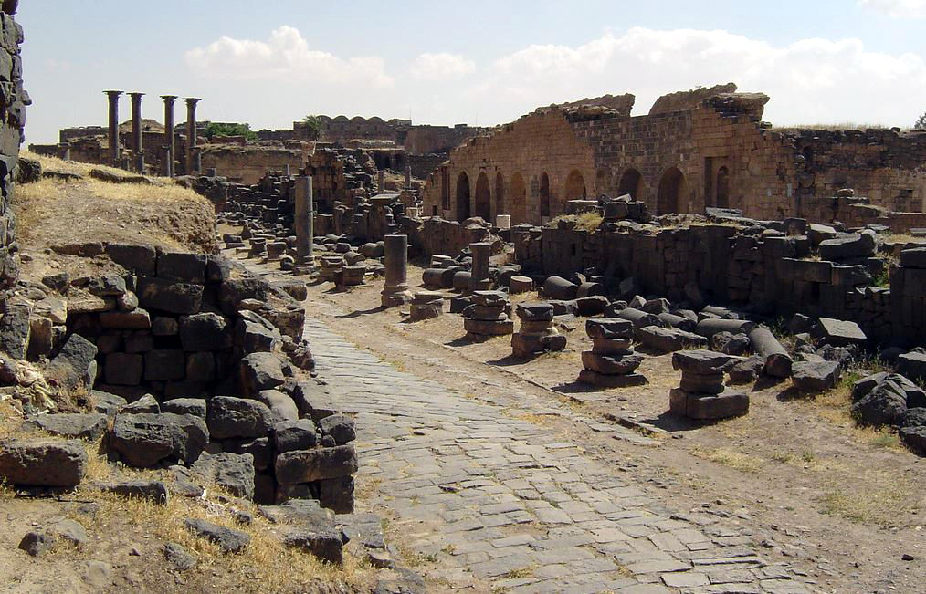
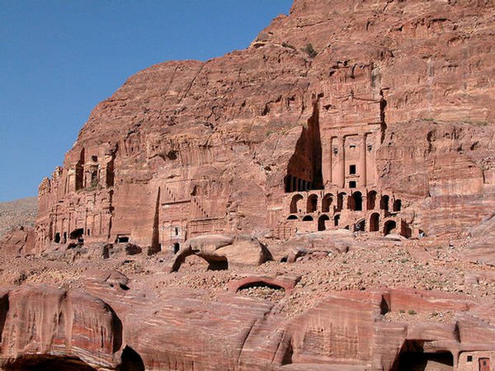
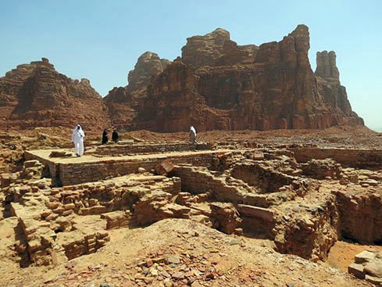
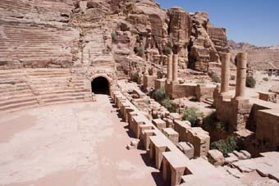
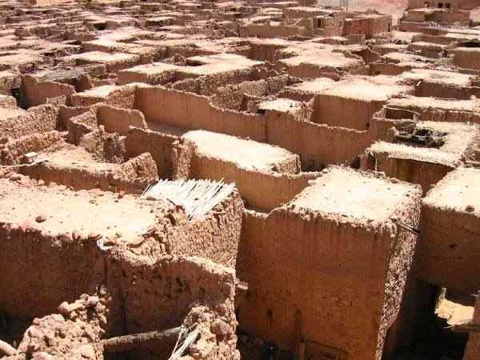
Ruins at Bozrah
Ruins at
Petra
Ruins at Dedan

Slide 32
THE FULFILLMENT OF THE PROPHECY - Copeland
ITS ULTIMATE FULFILLMENT... (A spiritual interpretation)
May likely have been with the coming of the Messiah, Jesus Christ!
For with His coming, and the establishment of the spiritual kingdom beginning in Jerusalem...
a. Deliverance and holiness did come from Mt. Zion (i.e. Jerusalem) - Lk 24:47
b. The kingdom (rule) is the Lord's! - cf. Lk 1:31-34; Mt 28:18; 1Pet 3:22; Rev 1:5
c. The house of Jacob (i.e., the true spiritual Israel) did possess Edom as
Gentiles among them became Christians! - cf. Rom 11:13-18 (where faithful Gentiles are spoken as being grafted into the stock of Israel.)
As support for this interpretation, consider:
a. The prophecy of Balaam - Num 24:15-19 which foretells how "A Star shall come out of Jacob, A Scepter shall rise out of Israel" (the Messiah?) b. And how Edom will become a possession. (Num 24:18)
c. The prophecy of Amos in possessing the remnant of Edom (Am 9:11-12)
d. The application by James at the council in Jerusalem (Acts 15:13-17) who understood the conversion of the Gentiles to be a fulfillment of Amos.
Therefore the fulfillment may also be figurative as Gentiles become Christians.

Slide 33
Lessons Learned from Obadiah
Pride goes before destruction (Prov 16:18)
Pride leads to vanity and a sense of independence from God, just as Edom took pride in their geographical location, allies, wisdom and might. Such arrogance God will punish - cf. Isa 13:9-11
-- Are we on guard against such pride?
Do not mistreat your brethren.
Edom was guilty of this, on multiple occasions. How we treat our brethren affects our relationship with the Lord - cf. 1 Cor 8:12
-- Are we careful about our dealings with our brethren?
Do not rejoice when your enemy falls (Prov 24:17-18)
This Edom did when Judah was plundered. This sort of gloating is clearly displeasing to God!
-- Do we rejoice when our enemy falls?
In time of divine judgment, God will provide a means and place of escape for those who turn to Him.
Note again verse 17, where Mount Zion would become a place of deliverance. Today, spiritual Mount Zion is a place to which we can turn - cf. Heb 12:22-24. It is a place where we can find:

Slide 34
Lessons Learned from Obadiah
From Heb 12:22-24. It is a place where we can find:
"the city of the living God"
"the heavenly Jerusalem"
"an innumerable company of angels"
"the firstborn registered in heaven"
"God the Judge of all"
"the spirits of just men made perfect"
"Jesus the Mediator of the new covenant"
"the blood of sprinkling that speaks better things than that of Abel"
Of course, this is what we come to as we obey the gospel of Christ!

Slide 35
Conclusion
With this brief look at "The Book Of Obadiah“ we have seen that ...
The prophets were not limited in their prophecies to just the nation of Israel.
God held the heathen nations accountable for their actions.
While it was written primarily to comfort the Israelites in Obadiah's day, there are lessons for us as well. The message of hope may have had its ultimate fulfillment in what we can enjoy ourselves in the person and work of Jesus!
In verse 15, we find the expression: "the day of the Lord"...
This expression is often used by the prophets when referring to God's judgment upon the nations.
The particular "day of the Lord" of which Obadiah wrote was "near" and was fulfilled with the destruction of Edom.
But there is another "day of the Lord" yet to come...!
Of which God's judgments upon the nations were only a shadow, a type.
Peter writes of that day in which the whole world will be judged (2 Pet 3:7-13)
Are we ready for that "day of the Lord"? Or do we in our arrogance take pride in our wisdom, might, or position in life? If so, "the pride of your heart has deceived you" (vs 3). How much better to humbly recognize that "...on Mount Zion there shall be deliverance, and there shall be holiness;" (Obad 1:17)
Have you come to Mount Zion and to Jesus the Mediator of the New Covenant?

Slide 36
Obadiah
“Servant of Yahweh”
846 BC or 586 BC
Jacob & Esau –
from brothers
to nations
(read Gen. 25:
22-26;36:7-8)
Edom’s Humiliation
and
Destruction
Edom’s Cruelty
and
Crimes
Edom and the
Day of the Lord
Verses
1-9
Verses
10-14
Verses
15-21
Portent
Prediction
Denunciation
Consummation
Event
What will happen
Why it will happen
How it will happen
“The arrogance of your heart
has deceived you… I will bring you down.” (vv.3-4)
“Because of violence to your
brother Jacob…” (v.10)
“As you have done, it
will be done to you.” (v.5)
Content
Theme
The coming judgment of Edom
Key Verse
“Because of violence to your brother Jacob, You will be covered with shame,
And you will be cut off forever.” (v. 10)
Christ in
Obadiah
God’s judgment of Edom and deliverance of Israel – prefigure Christ’s salvation and judgment .
Notes:
The book of Obadiah is a strong warning to the proud. If assessed by its length one could say it is the “most minor” of all the minor prophets. It is the shortest book of the Old Testament. In the Symphony of the Scriptures, Obadiah seems to play an insignificant part in the orchestra’s performance. Not so! It’s twenty-one verses remind us in a powerful way that God stands by His redeemed. It is a small book that teaches great lessons. He had promised that the wicked nations who had persecuted God’s people would be be brought to their knees. Obadiah is a fresh reminder that, no matter who is against us, God is for us. While we cannot be sure about the date of this prophecy or the identity of the author, the author’s emphasis on Jerusalem suggests that he resided in the holy city. Unlike other prophets, Obadiah provides no strong rebukes to either Judah or Israel. Dating the book of Obadiah accurately is nearly impossible due to the scant historical information contained in the book. While several options have been proposed by scholars, the best argument places Obadiah in the 840s BC, making him the earliest writing prophet, a few years prior to Joel, and a contemporary of Elisha. The biggest piece of evidence for this early date comes from Obadiah 1:10–14, which indicates an Edomite invasion of Jerusalem. While Edom was too weak a nation to ever invade Judah on its own, Edom no doubt participated with other nations when the winds of change blew in its favor. Obadiah 1:10–14 pictures the violent behavior that the Edomites carried out on their neighbors, waiting on nearby roads to cut down those fleeing from the invaders within Jerusalem. The Edomites could have easily heard of Jerusalem’s invasion by foreign powers and entered themselves into the fray so that they too might benefit from plundering their neighbors in Jerusalem. The conflict between Edom and Israel is mentioned in more Old Testament books than it is against any foreign nation (Isa. 11:14; 34:5-17; 63:1-6; Jer. 9:25-26; 25:17-26; 49:7-22; Lam. 4:21-22; Ezek. 25:12-14; 35; Joel 3:19; Amos 1:11-12; Mal. 1:4). This leads one to ask, “What did Edom do to arouse God’s wrath?” Located to the east and south, they were proud, arrogant and self-sufficient. Most of all, they looked down on and hated the chosen people of God -- an animosity that went all the way back to Genesis. Remember that Esau had traded his birthright for a bowl of soup and “two nations” were formed with the older (Esau) serving the younger (Jacob) (Gen. 25:22-26). Later, Esau becomes Edom (“red”) and after Jacob, with his mother’s help, deceives his father and receives the blessing intended for the older brother. Esau vows he will kill Jacob for stealing his birthright. Both Esau and Jacob initially settled in Canaan but the two became two nations -- Jacob became Israel - Esau became Edom. When the land “could not sustain them” (Gen. 36:7), Esau moved to the “the hill country of Seir” (36:8), leaving Jacob with all of Canaan. The animosity of the two nations flourished when Edom refused passage through their land to the fleeing Israelites who had escaped Egyptian slavery (Ex. 12:40-41; Nu. 20:14-21. Note: the ancient fortress of Petra (Sela) provided a high/safe place where passageway was extremely difficult and it made it easy for them to wage war and levy tribute to those passing by No wonder the Edomites would crow, “Who will bring me down to earth?” (v.3). “I will,” says God! One person wrote, “Edom has become guilty of misplaced pride, glorying in its own accomplishments, oblivious to the reality that God is in charge and their success or failure is in God’s hands.” --- Daniel J. Simundson, Truth for Today, The Minor Prophets-2, page 31.
Application
God is for His people and with His people. What enemy should we fear?
It is not just God’s enemies that can become prideful; God took Israel and Judah down for their self-exaltation as well.
We need to remember that God wants us to depend on Him - to find our security in Him. He alone is our Fortress, our Rock, Shield, and Protector. He is the Source of our blessings.
Be assured, if we think too highly of ourselves, God will bring us down!
Key thought: “Pride goes before destruction, and a haughty spirit before a fall” (Pro. 16:18; 1 Pe. 5:6).

